Slide 1
BAAS DATA ACCESS LAYER

Slide 2
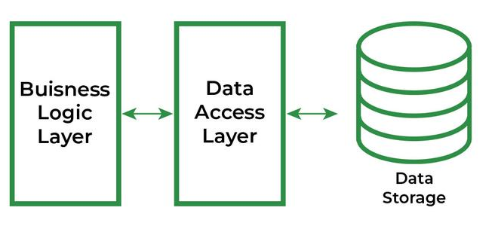
Meaning & Overview
A data access layer (DAL) in computer software, is a layer of a computer program which provides simplified access to data stored in persistent storage of some kind, such as an entity-relational database.
Note: Persistent storage means a storage device that retains data after power to that device is shut off.
The DAL hides this complexity of the data store from the external world.
Layman Understanding: DAL maintains the Database, Any software layer which want to go through/access the database first they need to go through the Data Access Layer.
It is the place where do we perform all the CRUD Operations[Create, Read, Update, Delete]

Slide 3
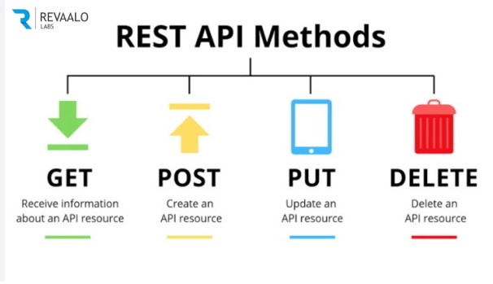
Characteristics of DAL
It can support multiple database, so the application is able to make use of any database as per its requirement.
Because segregating the data access code, enables better maintainability and easy migration of the database.
It contains methods for accessing the underlying database data.
As we read earlier, in this layer we do perform all the CRUD Operations by using all the REST API methods(GET,POST,PATCH/PUT,DELETE)

Slide 4
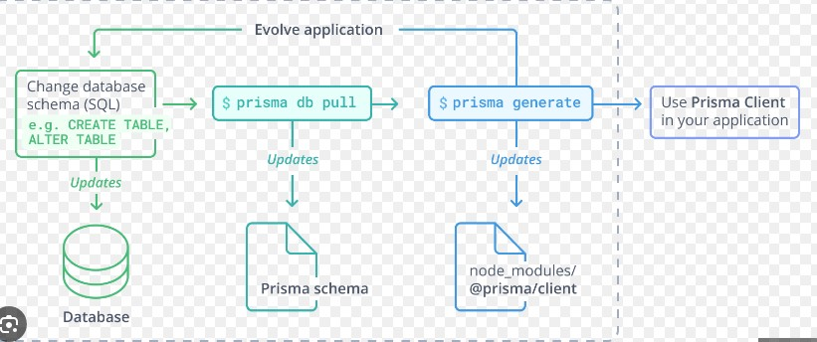
DAL Interaction with ORM
ORM is known as Object-Relational Mapping Tools, it is a layer that connects object-oriented programming (OOP) to relational databases.
PRISMA:
Prisma is a next-generation ORM that consists of these tools:
Prisma Client: Auto-generated and type-safe query builder for Node.js & TypeScript
Prisma Migrate: Declarative data modeling & migration system
Prisma Studio: GUI to view and edit data in your database
Prisma Client can be used in any Node.js or TypeScript backend application (including serverless applications and microservices). This can be a REST API, a GraphQL API a gRPC API, or anything else that needs a database.

Slide 5
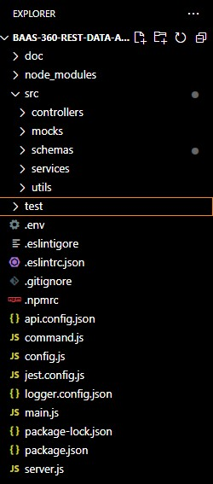
Code Base Followed in DAL
doc
node_modules
src
controllers
mocks
schemas
services
utils
Test
env
eslintigore
eslintrc.json
gitignore
npmrc
api.config.json
command
config
Jest.config
Logger.config
main.js
Server.js

Slide 6
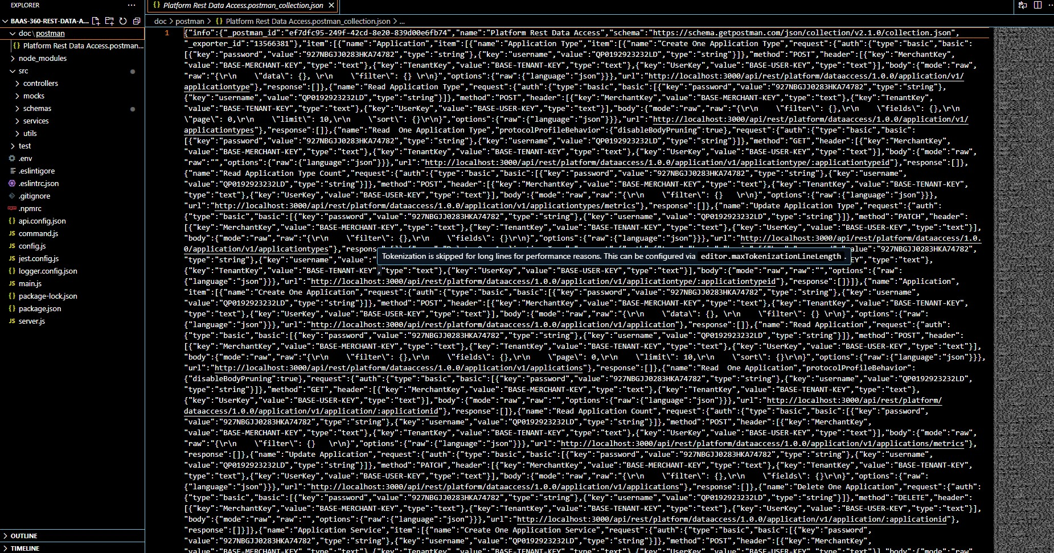
What is doc
Doc is a place where do we store the documentation
Here in our docs, we do create a postman named folder and in that we do create a postman collection Json

Slide 7
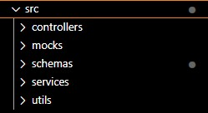
What is src
Source folder is used to hold the primary source files for the project.
The significance of the source folder vary depending on the context of the framework in use.
The extension for the files is ".js"
It consist of controllers, mocks, schemas, services, utils.
In schemas there would be a file called "schema.prisma" where there would be schemas of the required table and fields you want to provide.

Slide 8
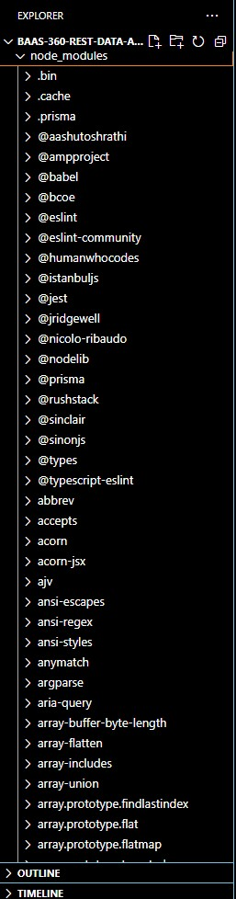
What are node_modules
modules are nothing but a block of encapsulated code that communicate with an external application basis of their related functionality.
modules can be single file or a collection of multiple files/folders

Slide 9
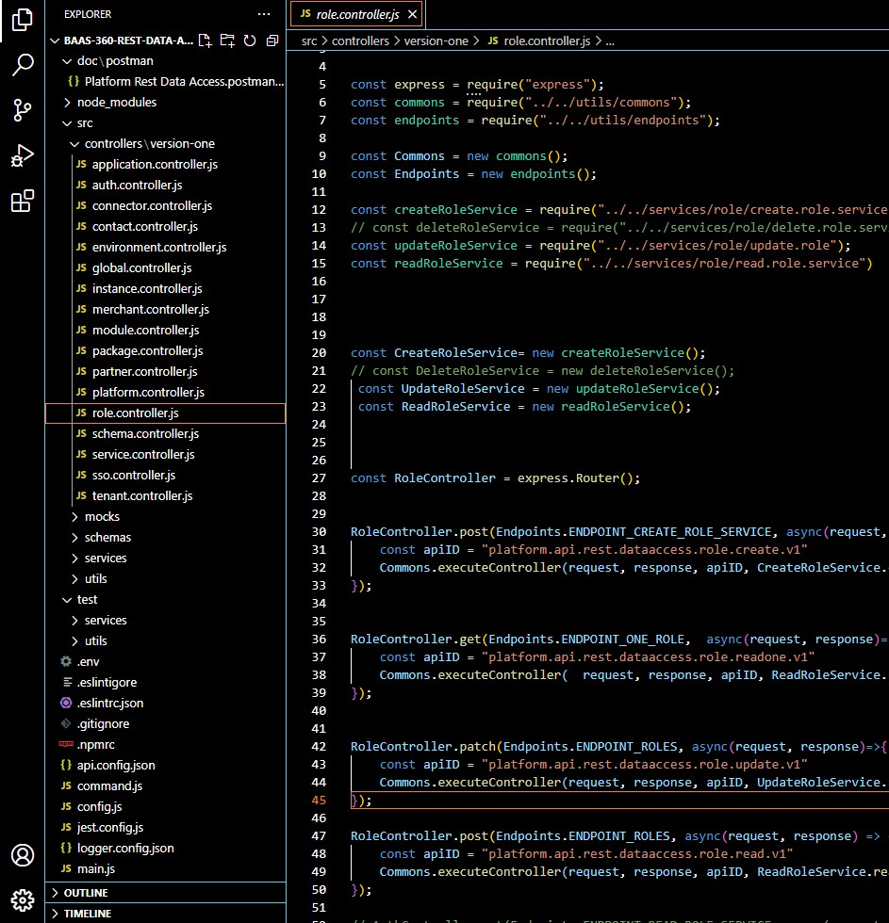
controllers
Controllers is the folder which contains all the specified Api[actual Api] with the respective file in it.
We will maintain one controller file for one module.
Here it is an example of code base in controllers, we do write all the Api's in controller file of respective module.
In this example methods like [post, get, delete, update] is done for the role module.

Slide 10
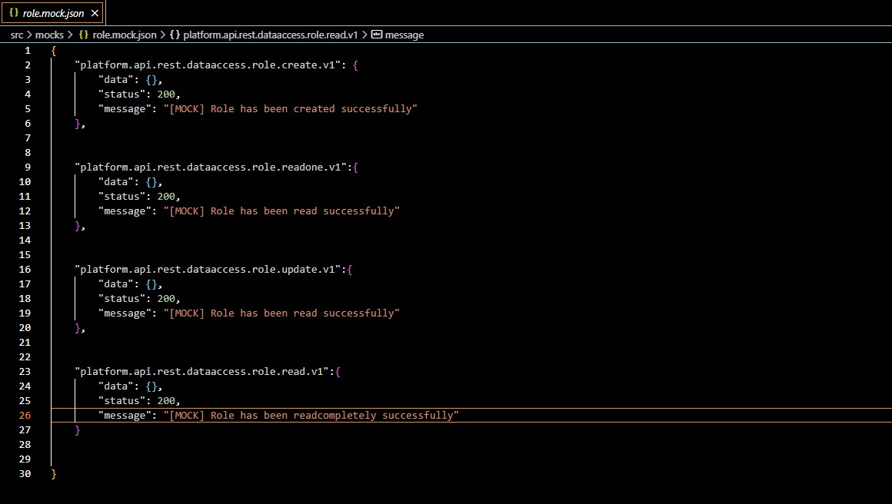
mocks
Mock is nothing but a Json which consist of Api id as a key and data, status and message as a value for it.
Mock is a static data of an api
It is the structure of the actual output.

Slide 11
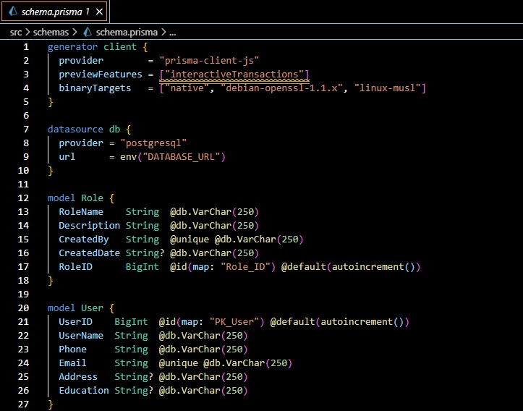
Schemas
The main configuration file for your Prisma setup
Schema consist of the structure of the table.
Prisma schema is the place where you define the structure of your needed table.

Slide 12
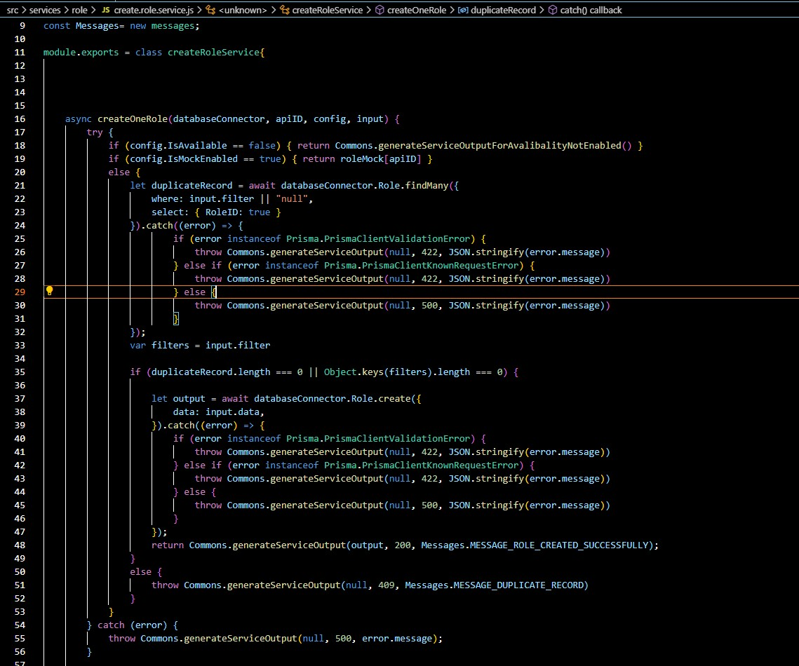
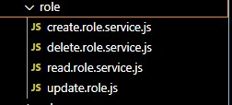
Services
Services is place where do we perform all the CRUD Operations by creating a six individual files for one folder
We do write the conditions that need to be performed
Here we connect with database

Slide 13
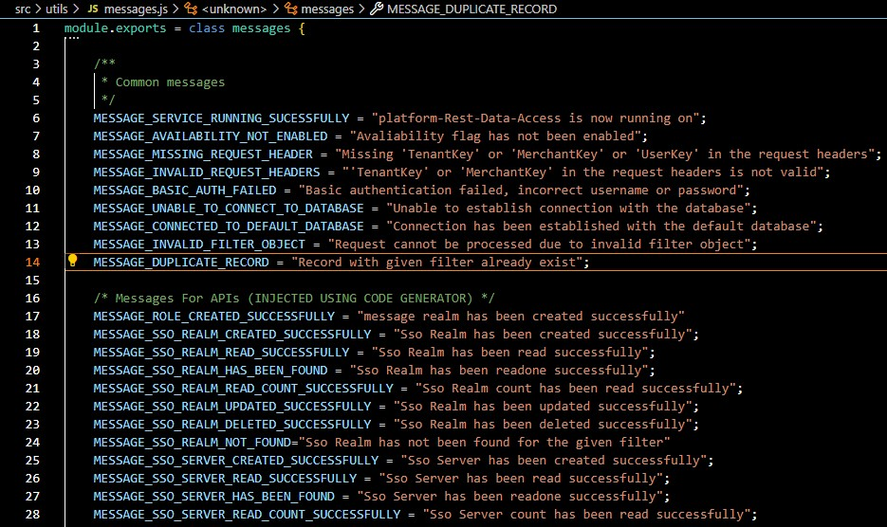
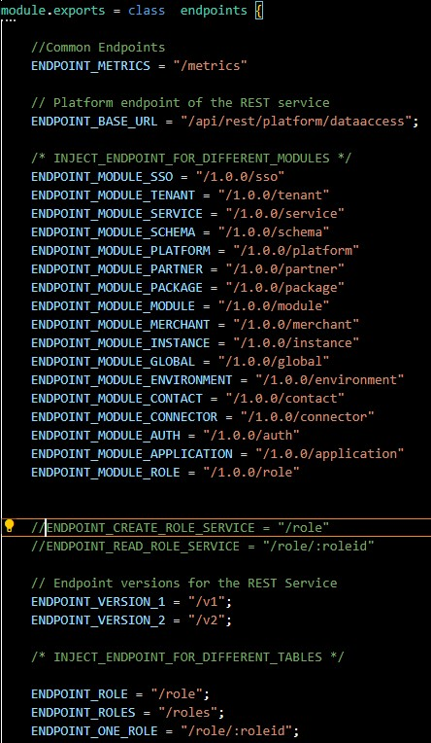
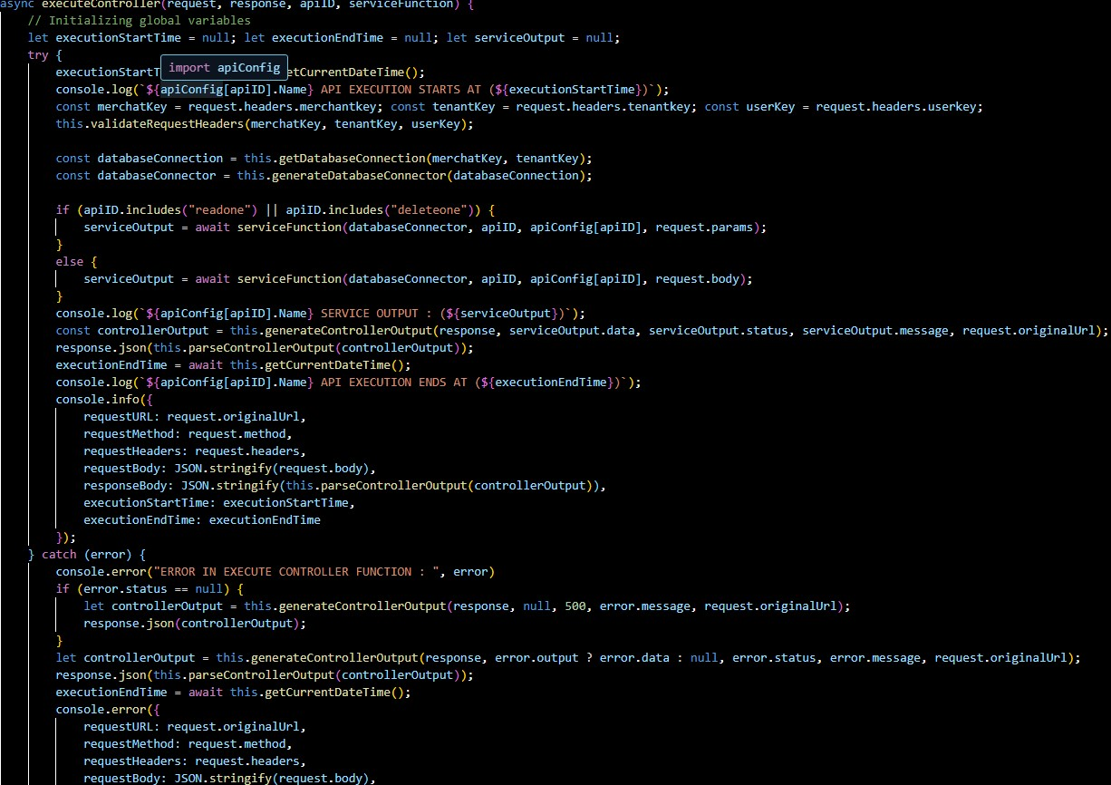
utils
It consist of commons, endpoints and messages
Commons:-It consists of code for service response, executing controllers, handling unauthorized responses, validates request headers and many more
Endpoints:-It contains all the endpoints required for the application
Messages:-It contains common messages that are required when the application is successful or failed.

Slide 14
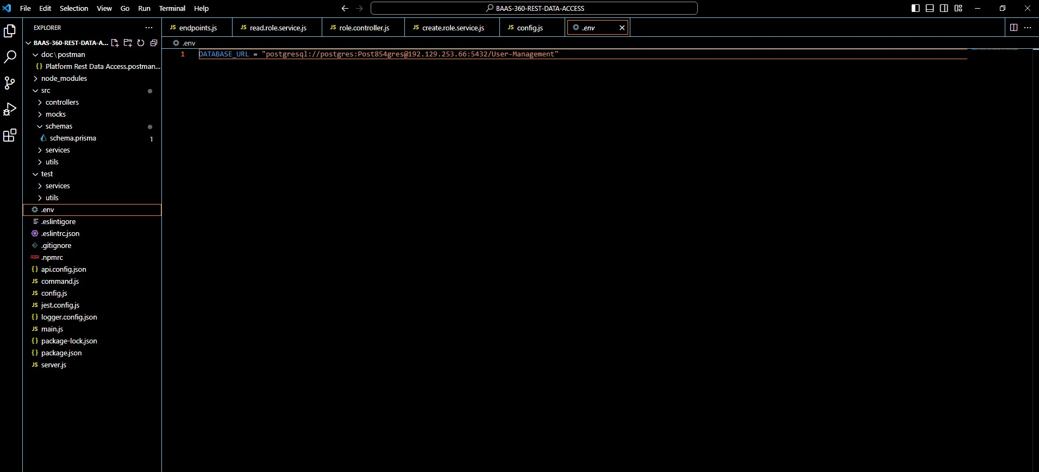
env
It consist of database URL , the database you are going to use .

Slide 15
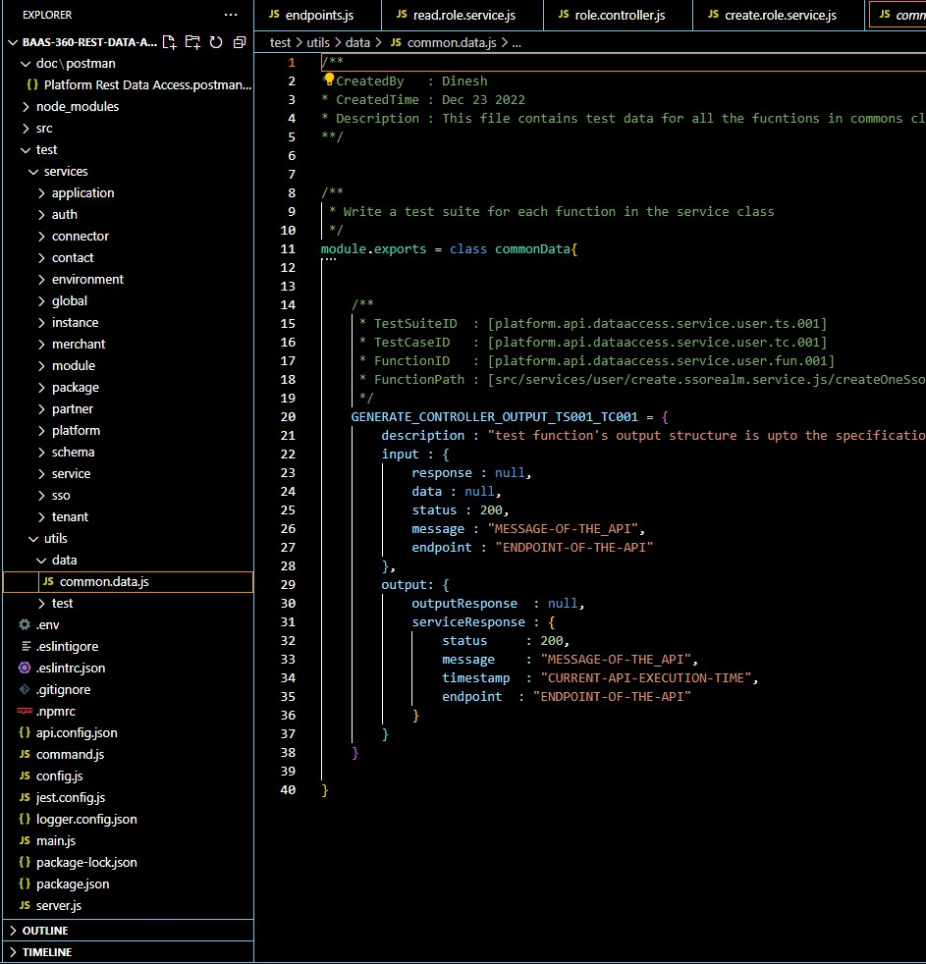
test
Test is for unitest
It consist of data and service
We write jest for unitest
It is file we write all the code in for the one common class

Slide 16
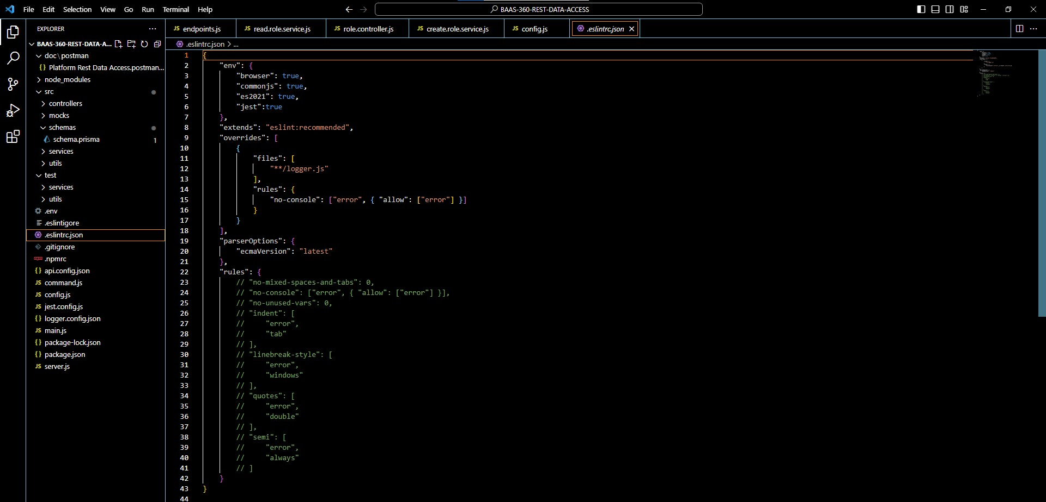
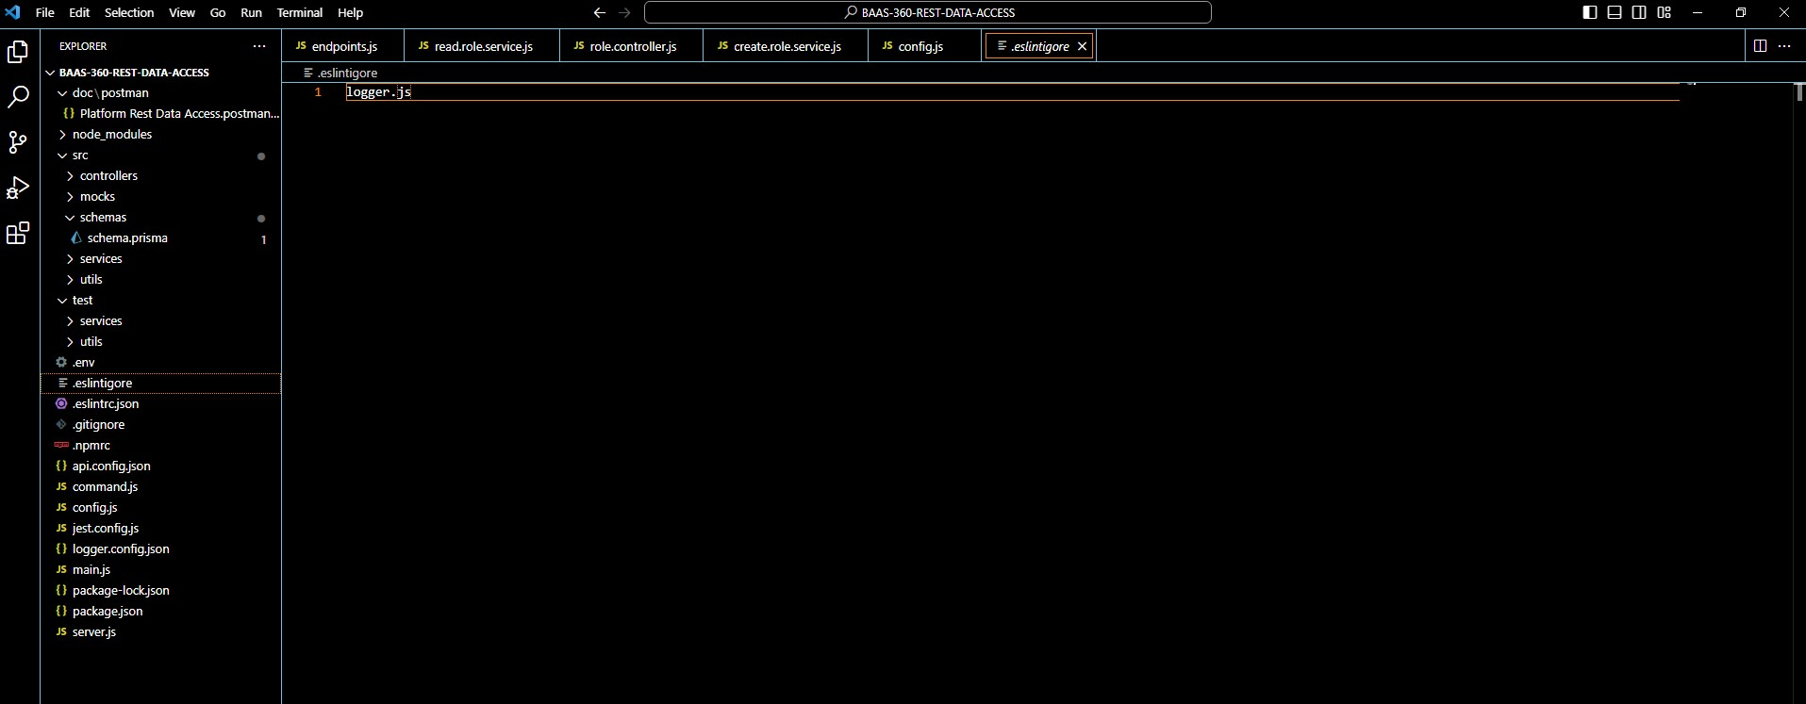
eslintigore & eslintrc.json
Configuration changes based on environment
Eslintrc is nothing but a static code analysis. It also consist of rules which are user-defined.
eslintigore is a file which consist the files which need to ignored at the time of execution.

Slide 17
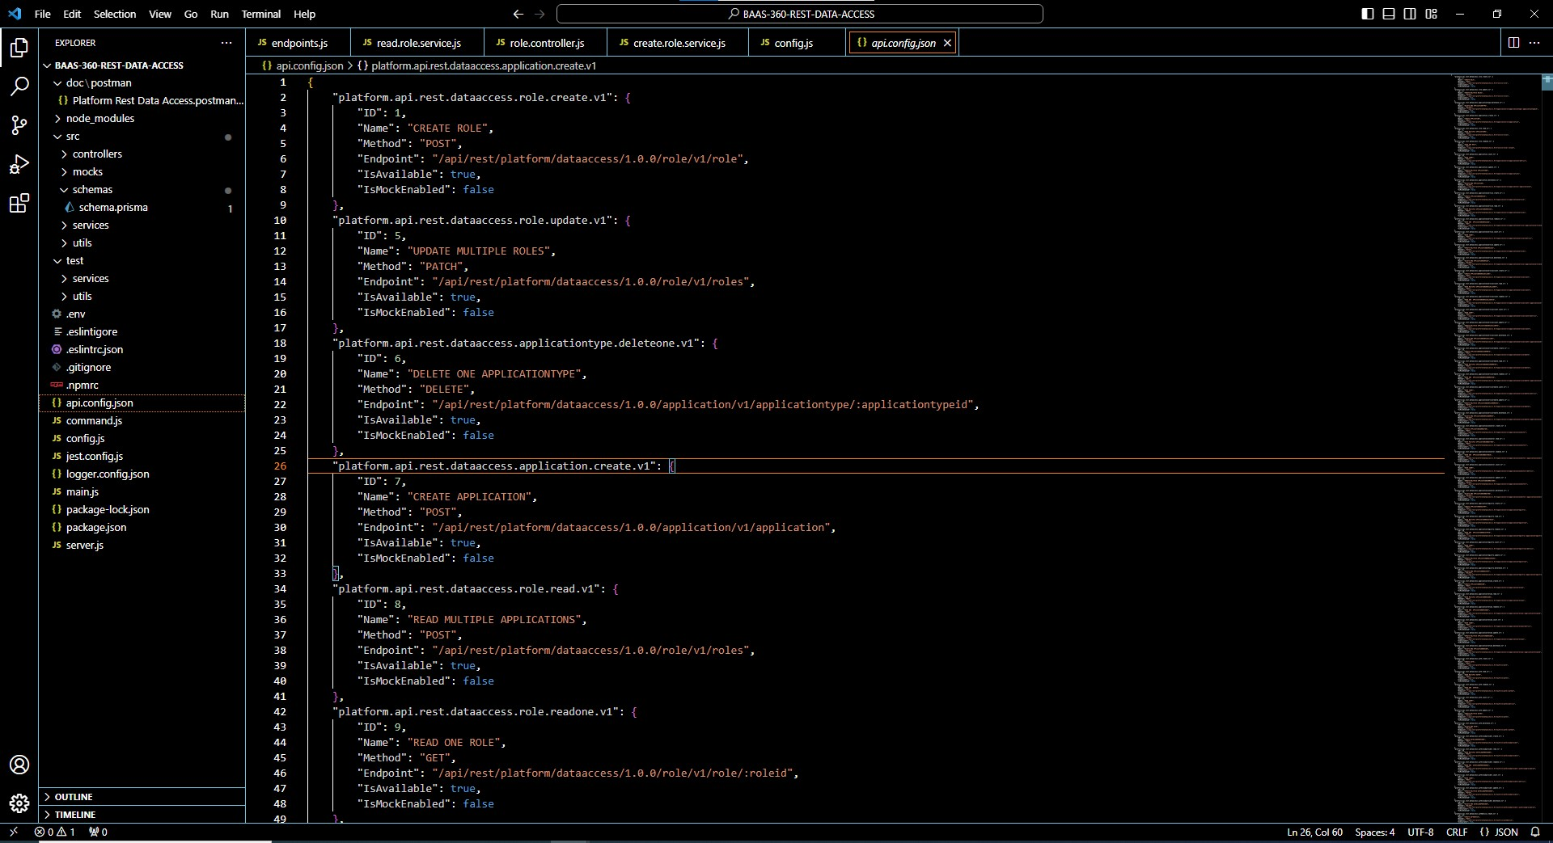
api.config.json
This consist of json which contains all the details like api method and api id the keys which you want to enable and disable.

Slide 18
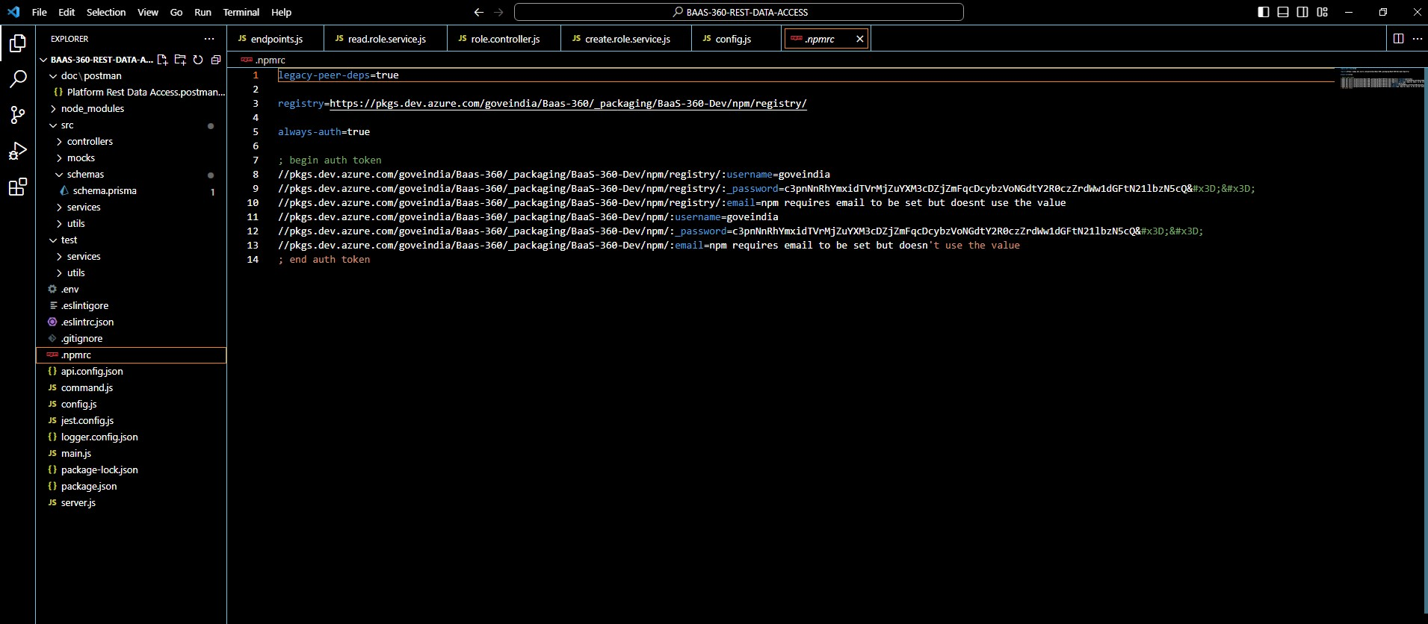
npmrc
We use npmrc to configure a private registry in project.
It manages the npm config file.
It defines the settings on how NPM should behave when running commands.

Slide 19
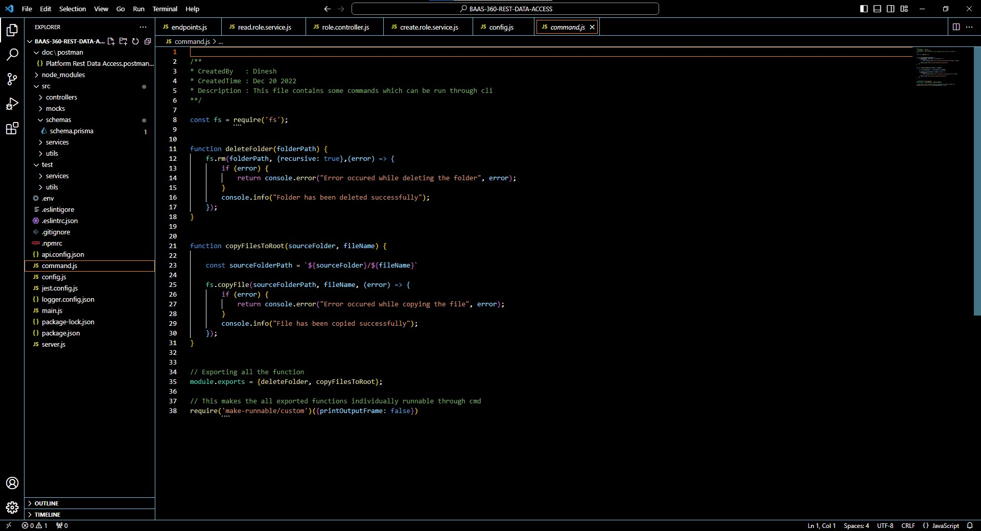
command
It contains some commands which run through cli
It uses file system to give path where file need to be copied and deleted.
All file system operations have synchronous, callback, and promise-based forms, and are accessible using both Common JS syntax and ES6 Modules (ESM).

Slide 20
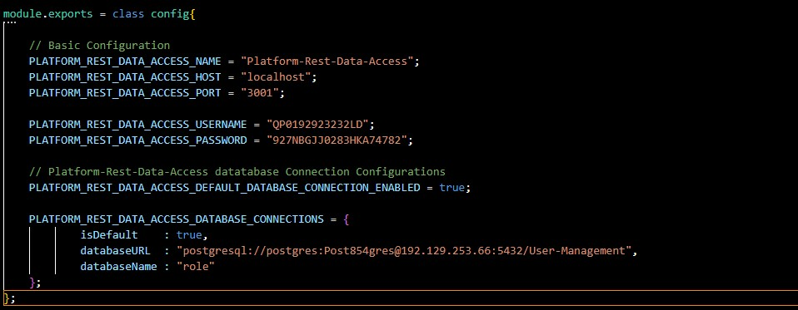
Config
It contains all the configuration that is required for the service.
It contains basic and database configurations to access the services.
It also contains basic authorization details.

Slide 21
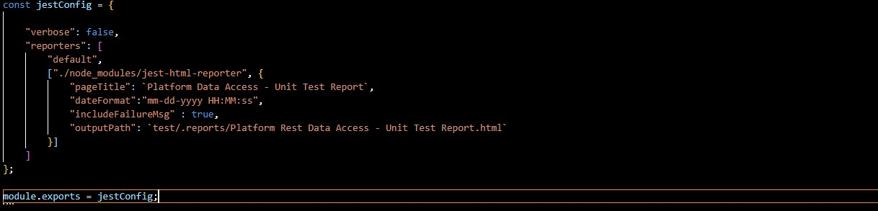
Jest.config
It gives the details and allows to know how much the code is true and false.

Slide 22
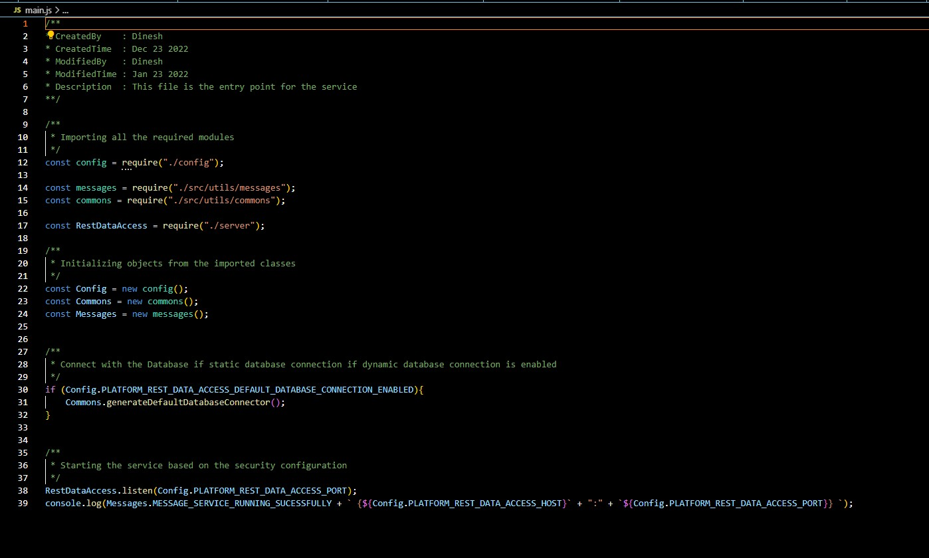
Main.js
This is the file where service gets started , it is considered as the entry point of the service.
Connection with the database would be enabled here.
It starts the service based on the security configuration.
It consist of package-lock-Json and package-Json.

Slide 23
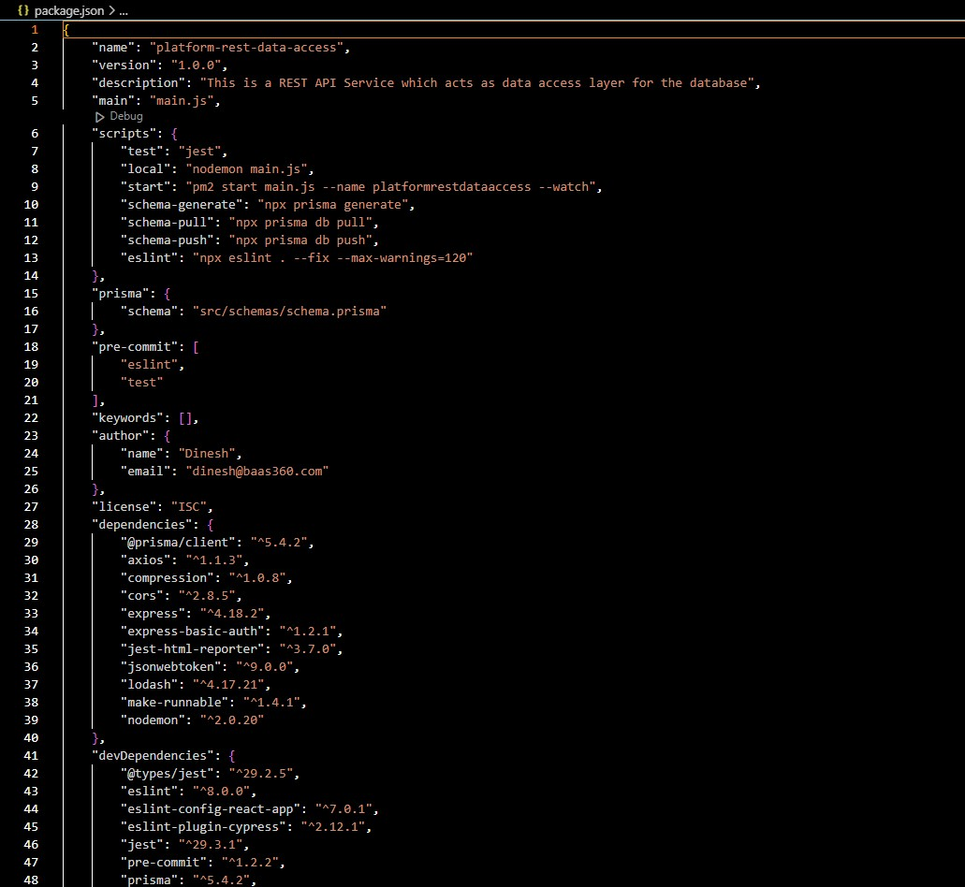
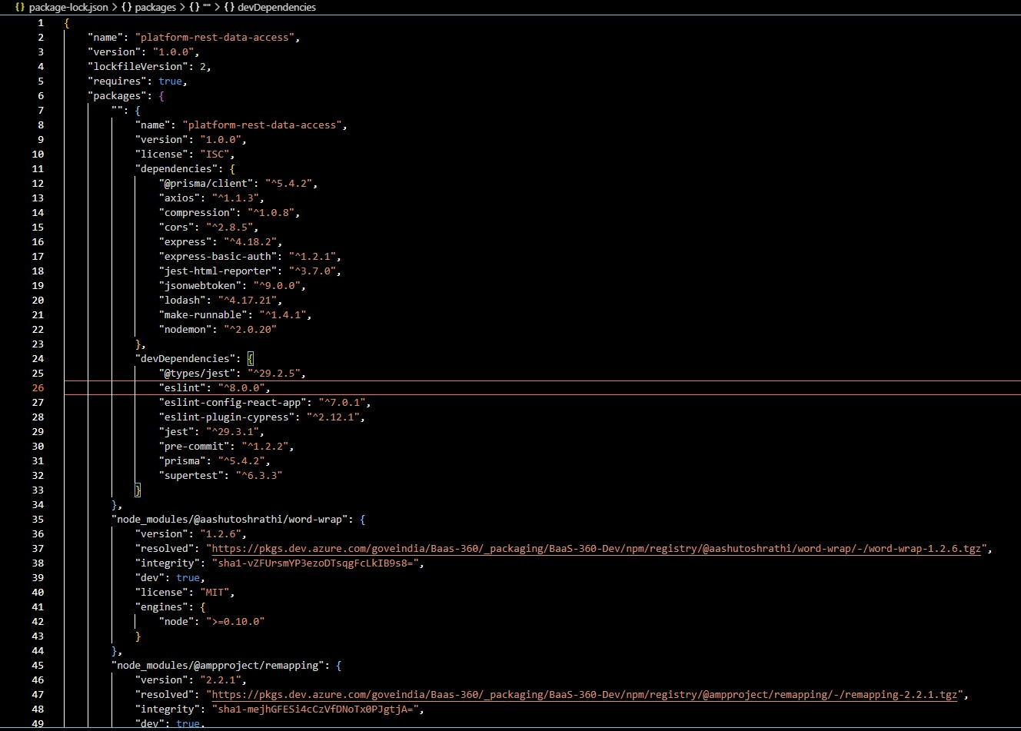
Package-lock. Json & package. Json
Package-lock. Json is automatically generated for any operations where npm modifies either the node_modules tree, or package. Json. It describes the exact tree that was generated, such that subsequent installs are able to generate identical trees, regardless of intermediate dependency updates.
It is the manifest file of any Node.js project and contains the metadata of the project. The package.json file is the essential part to understand, learn and work with the Node.js. It is the first step to learn about development in Node.js.

Slide 24
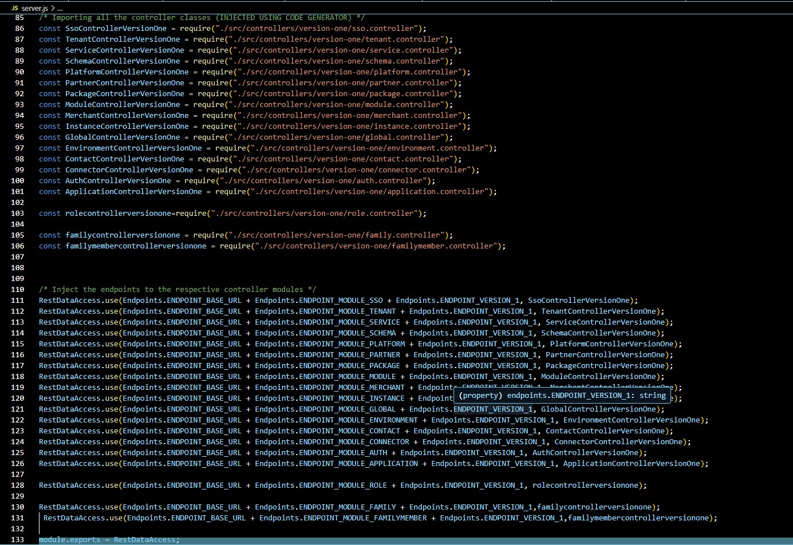
Server.JS
In this we do add the middle wares to the express.
In this we provide endpoints
The Endpoints are nothing the URL which is required to access the data access layer.
We add the service information endpoint without any authentication.
We do inject all the endpoint modules to the respective controllers.

